Slide 1
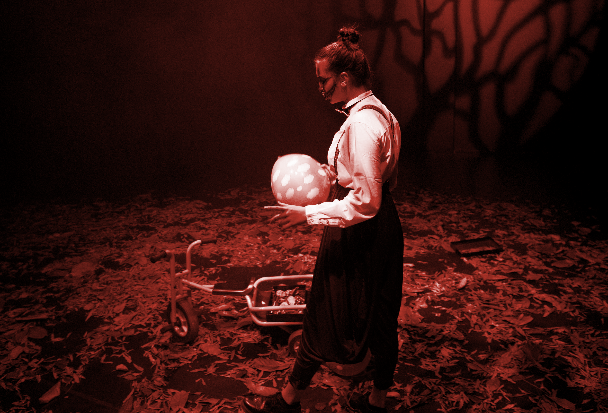
IB THEATRE
TRANSFORMATION.
IMAGINATION.
CONTROL.
Choices at WSA!

Slide 2
COLLABORATIVE THEATRE MAKING
INDEPENDENT THEATRE MAKING
CREATIVE EXPLORATIONS & PROCESS
DIRECTING & DESIGNING
PRESENTING RESEARCH
TECHNICAL THEATRE
PERFORMING

Slide 3
DIRECTOR
DESIGNER
CREATOR
TRANSFORMATION
PERFORMER

Slide 4
CHOOSE YOUR PLAYTEXT
CHOOSE YOUR RESEARCH
CHOOSE YOUR TOPICS
CHOOSE YOUR STIMULI
CHOOSE YOUR ROLE
CHOOSE YOUR ASSESSMENT
4 PROJECTS
(NO EXAM)

Slide 5
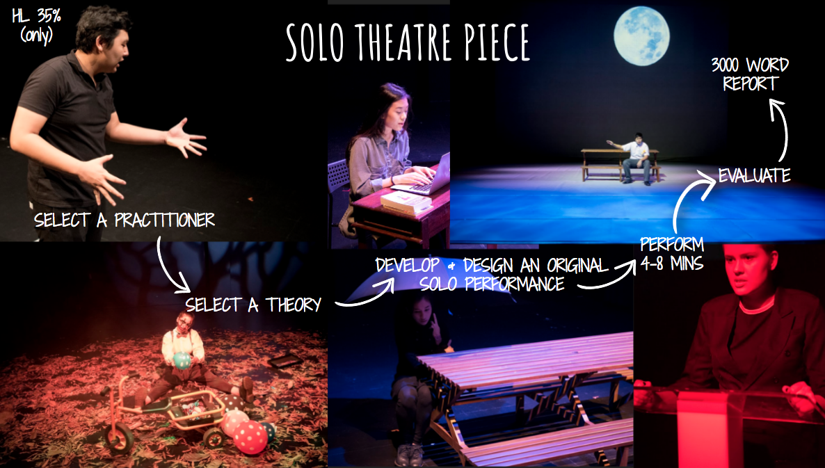
SL 40%
HL 20%
SL 30%
15 minute presentation
You film in five minute segments as you learn the material for each criteria.
Inquiring
Developing
Presenting
Evaluating
7-10 MIN PERFORMANCE
PROCESS PORTFOLIO
10 PAGES MAXIMUM
12 PAGES MAXIMUM
SL 30%
PRODUCTION PROPOSAL
STAGING ONE
MOMENT
THEATRE MAKERS INTENTION

Slide 6
In IB Theatre there are FOUR Assessments (HL) or THREE Assessments (SL) that make up your final score in the course. . .
There are no IB Theatre Exams at the end of the course.
For each assessment YOU CHOOSE the focus area that you would like to study

Slide 7
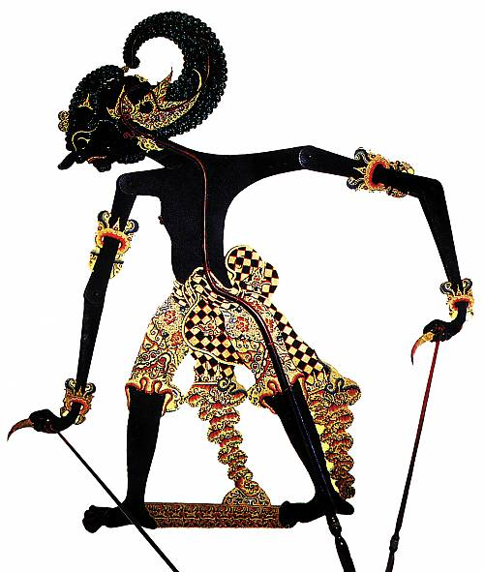
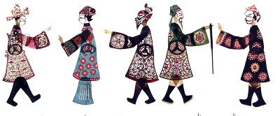
RESEARCH PRESENTATION
Collaborate and Discuss with your work with your Peers
You pick your tradition & convention
CHOOSE A WORLD THEATRE TRADITION
CHOOSE A PERFORMANCE CONVENTION
PRACTICAL & ACADEMIC RESEARCH
15 MINUTE PRESENTATION (FILMED)
You film in five-minute segments as you learn the material for each criteria.
CONTEXT
CONVENTION
MOMENT OF THEATRE
IMPACT ON LEARNER
HL 20%
SL 30%

Slide 8
MAKE A PIECE OF ORIGINAL THEATRE
FROM A CHOSEN STARTING POINT
YOU . .
CHOOSE YOUR GROUP
YOUR STARTING POINT
CREATE YOUR SHOW
DESIGN YOUR SHOW
7-10 MIN PERFORMANCE
10 PAGE (maximum)
PROCESS PORTFOLIO
HL 25%
SL 30%
COLLABORATIVE PROJECT
IMAGE: MUSKAAN VATVANI, 2018
IMAGE: MUSKAAN VATVANI, 2018

Slide 9
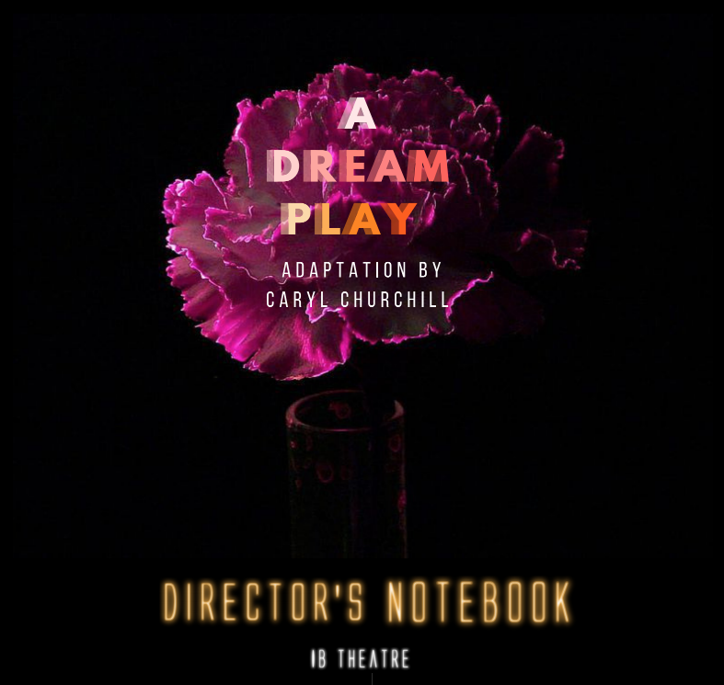
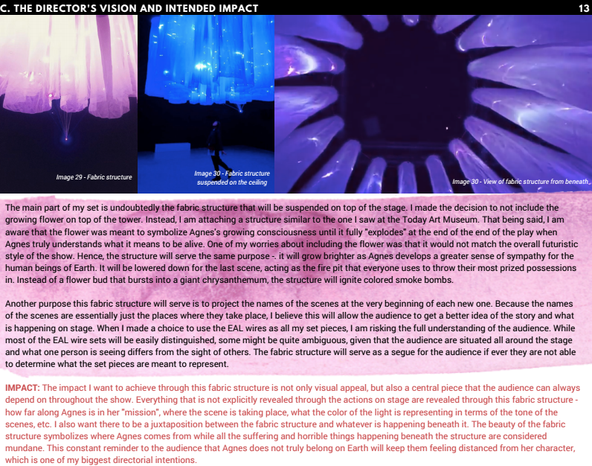
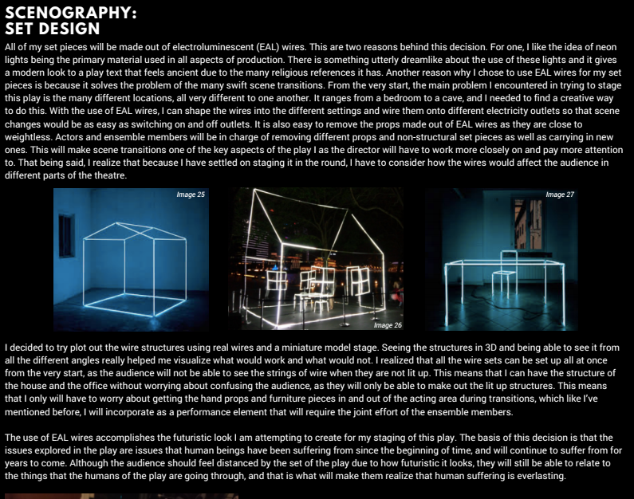
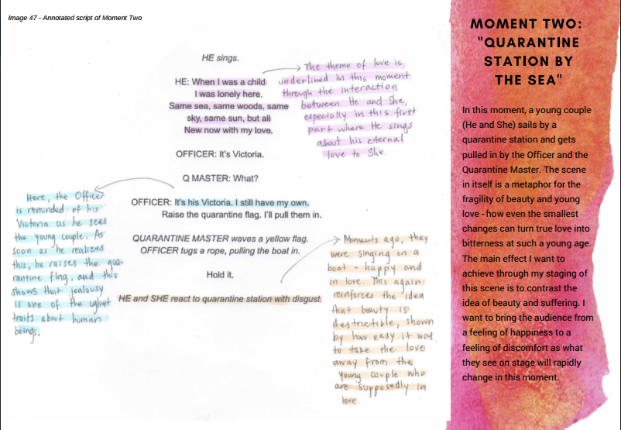
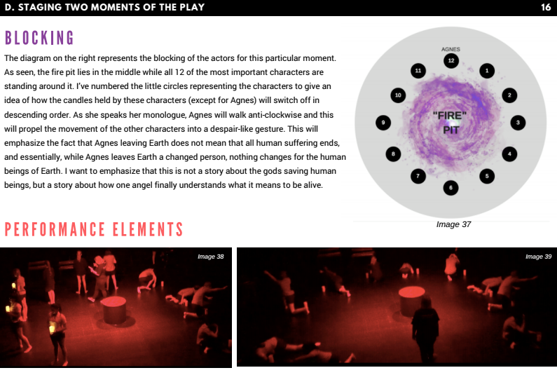
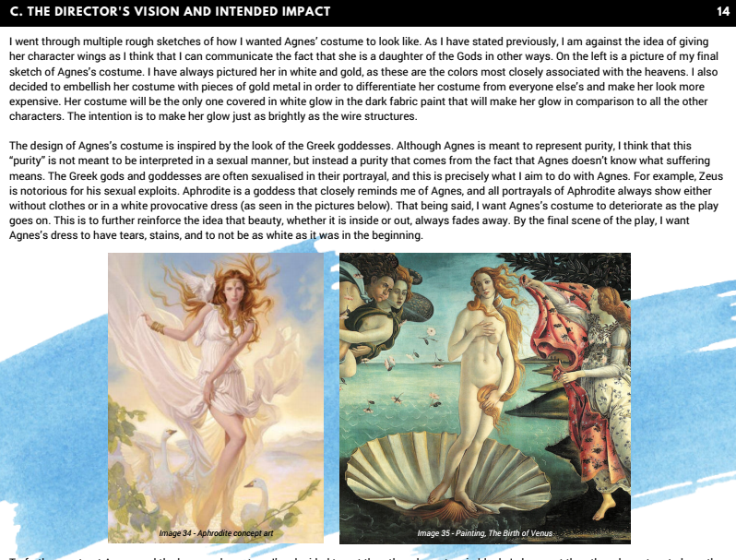
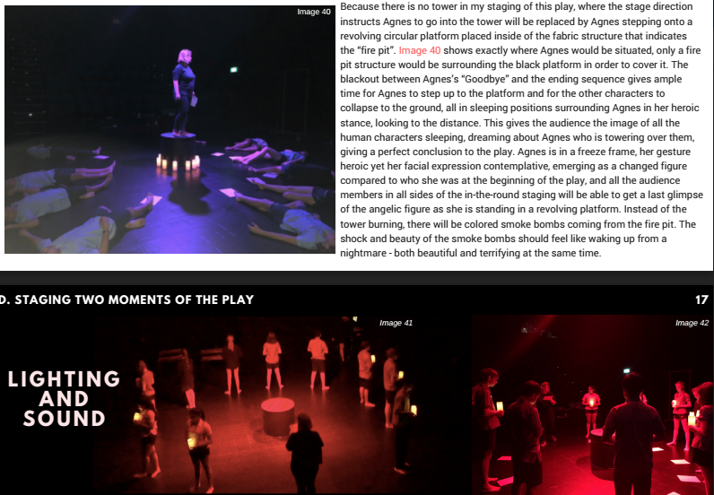
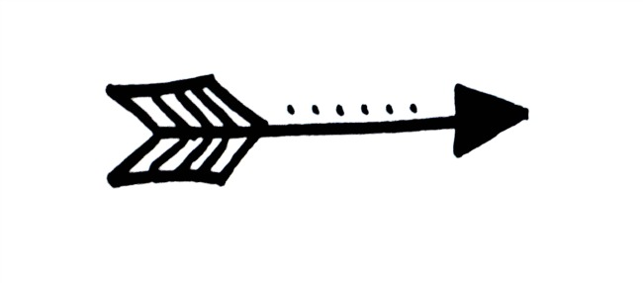
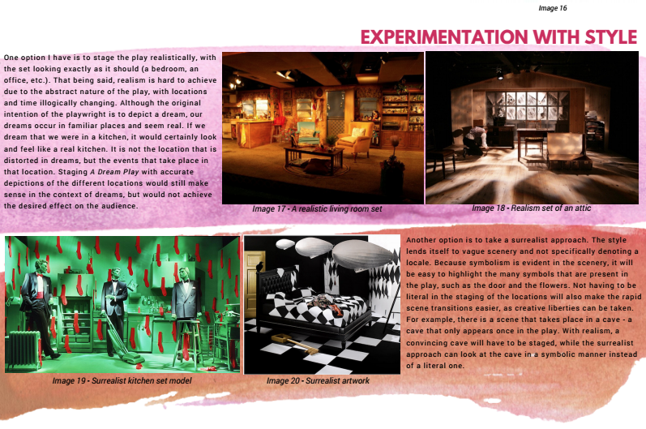
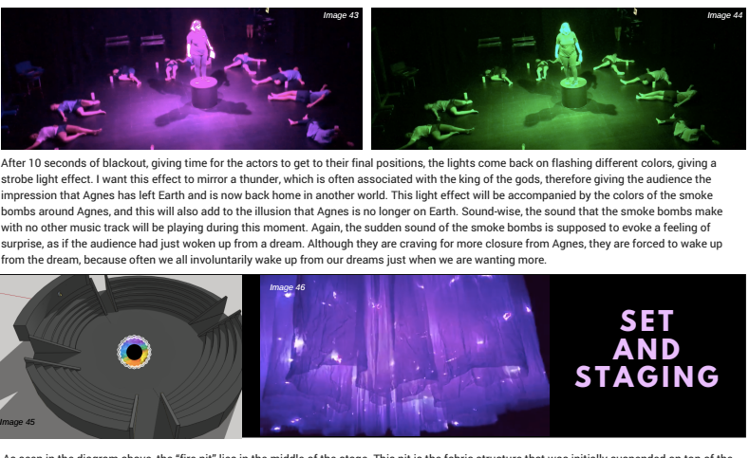
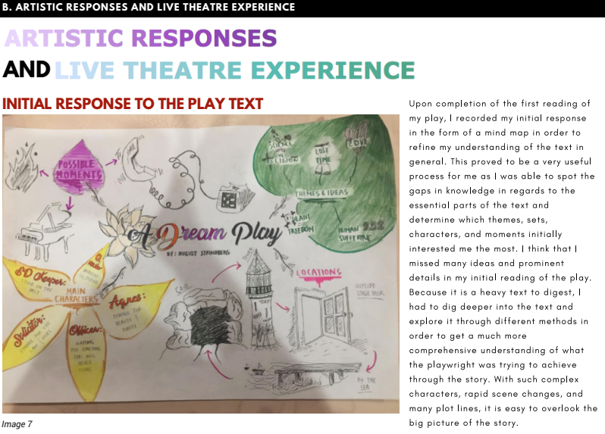
HL 20%
SL 30%
12 PAGES
Production Proposal (IA)
(LEGACY CURRICULUM - DIRECTOR’S NOTEBOOK)
CREATIVE PLANNING OF DIRECTORIAL VISION FOR SELF-SELECTED PLAY
TEXT
IMAGES
MIND MAPS
PHOTOGRAPHS
DESIGNS
CONTEXT & UNDERSTANDING
STAGING 1 MOMENT
Theatre Maker’s
Intention
DIRECTOR’S VISION

Slide 10
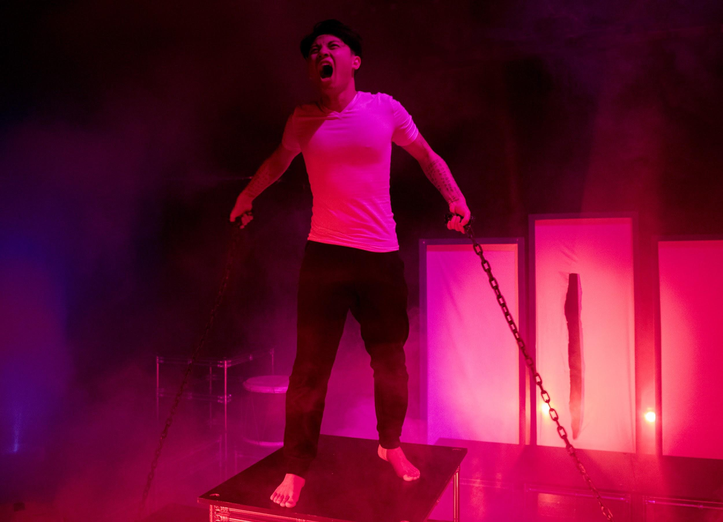
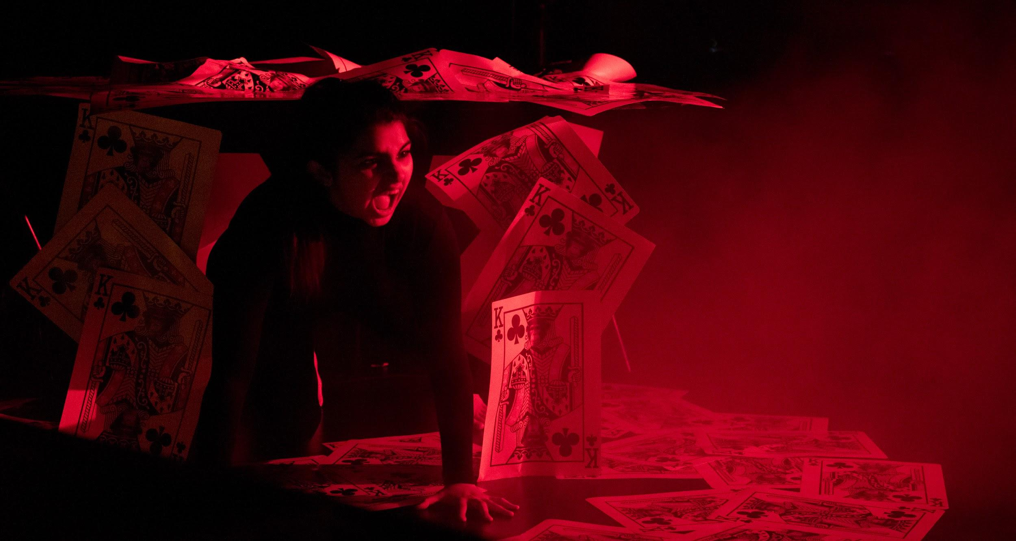
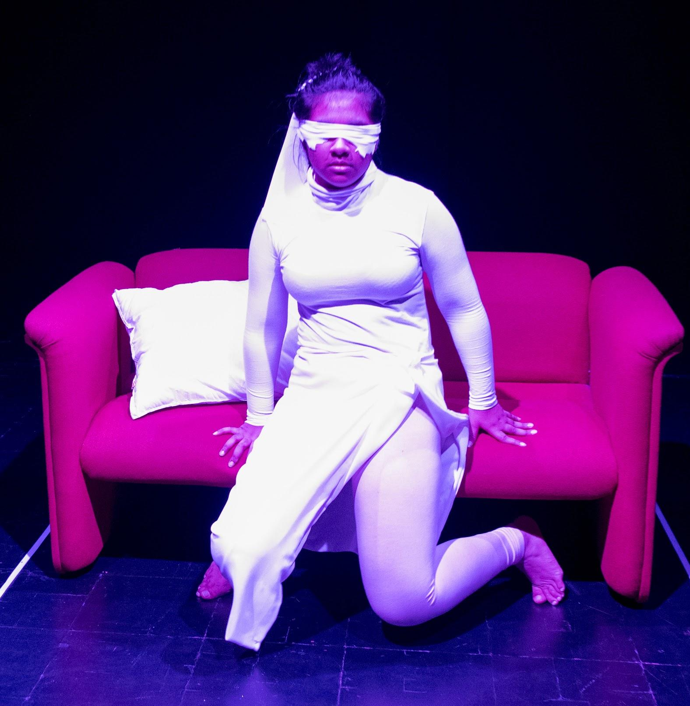
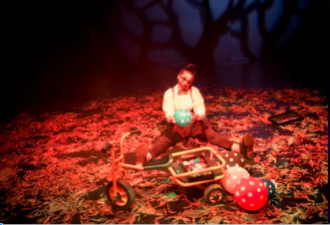
HL 35% (only)
SOLO THEATRE PIECE
2500 WORD (maximum)
REPORT
SELECT A PRACTITIONER
EVALUATE
DEVELOP & DESIGN
AN ORIGINAL SOLO PERFORMANCE
SELECT A THEORY
PERFORM
4-8 MINS

Slide 11
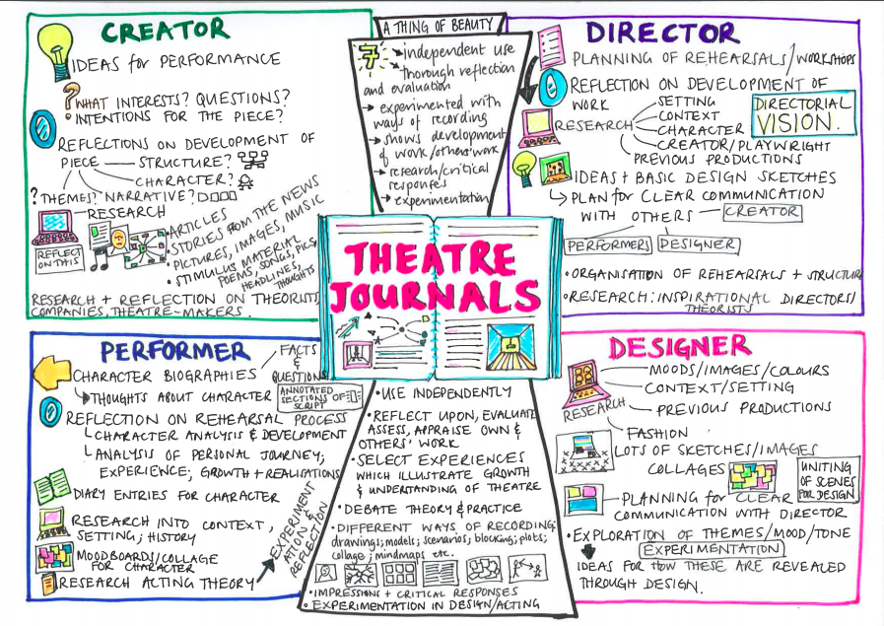

Slide 12
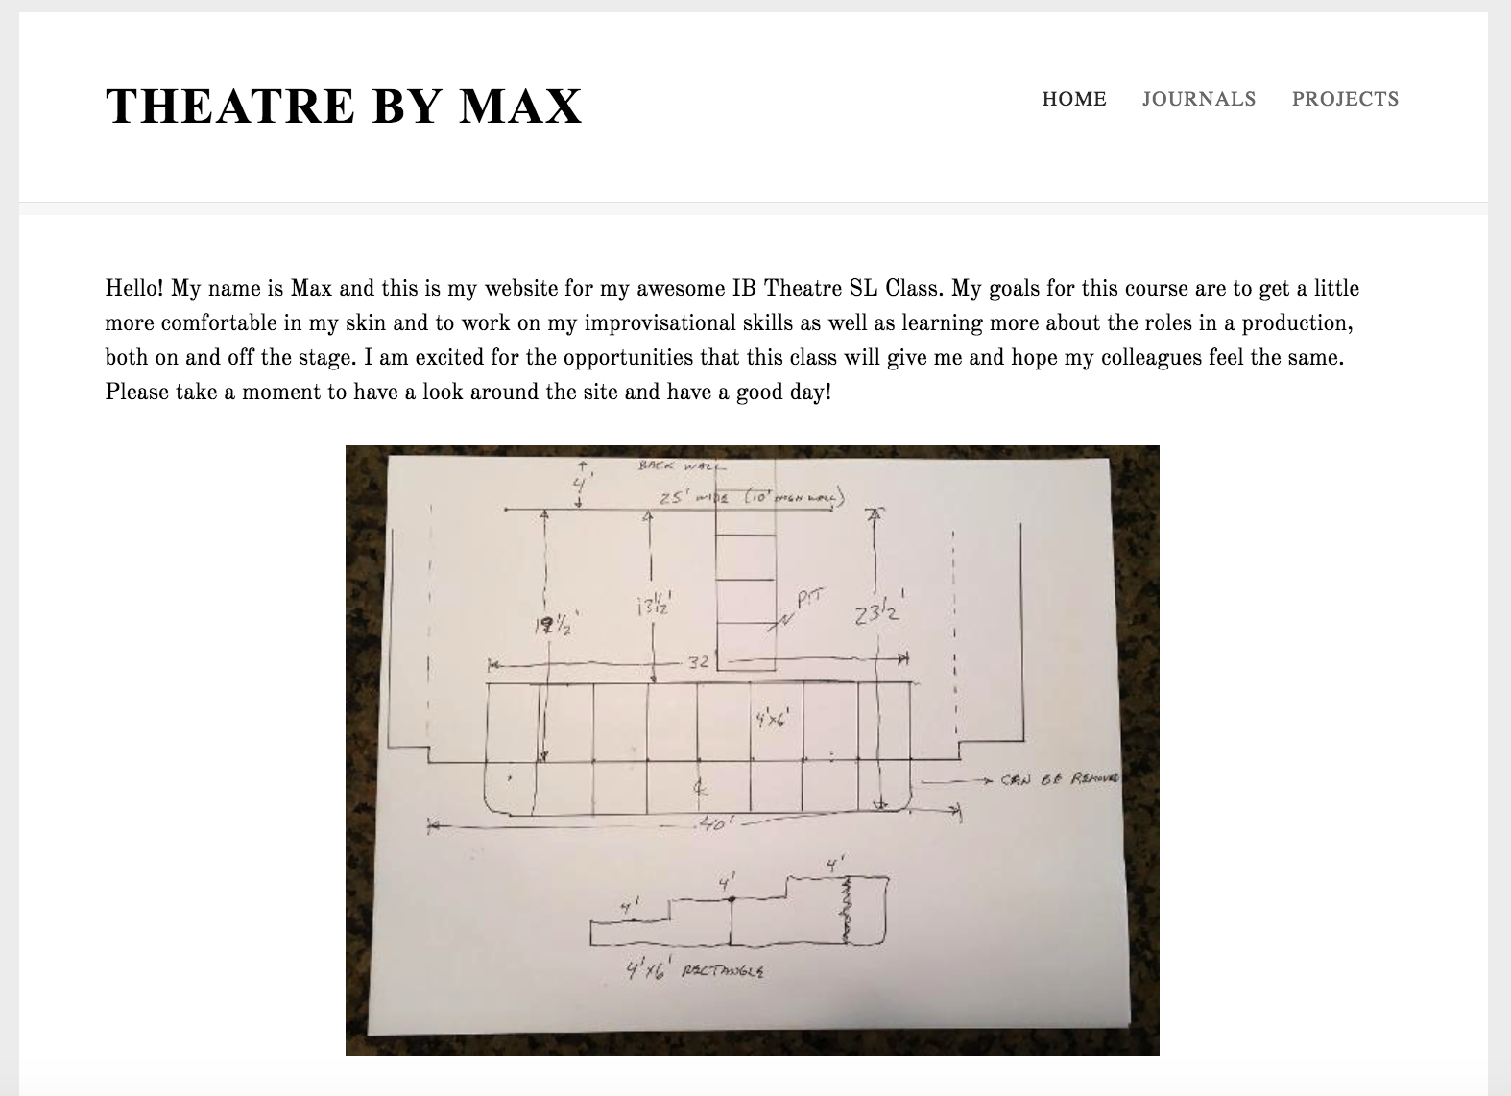
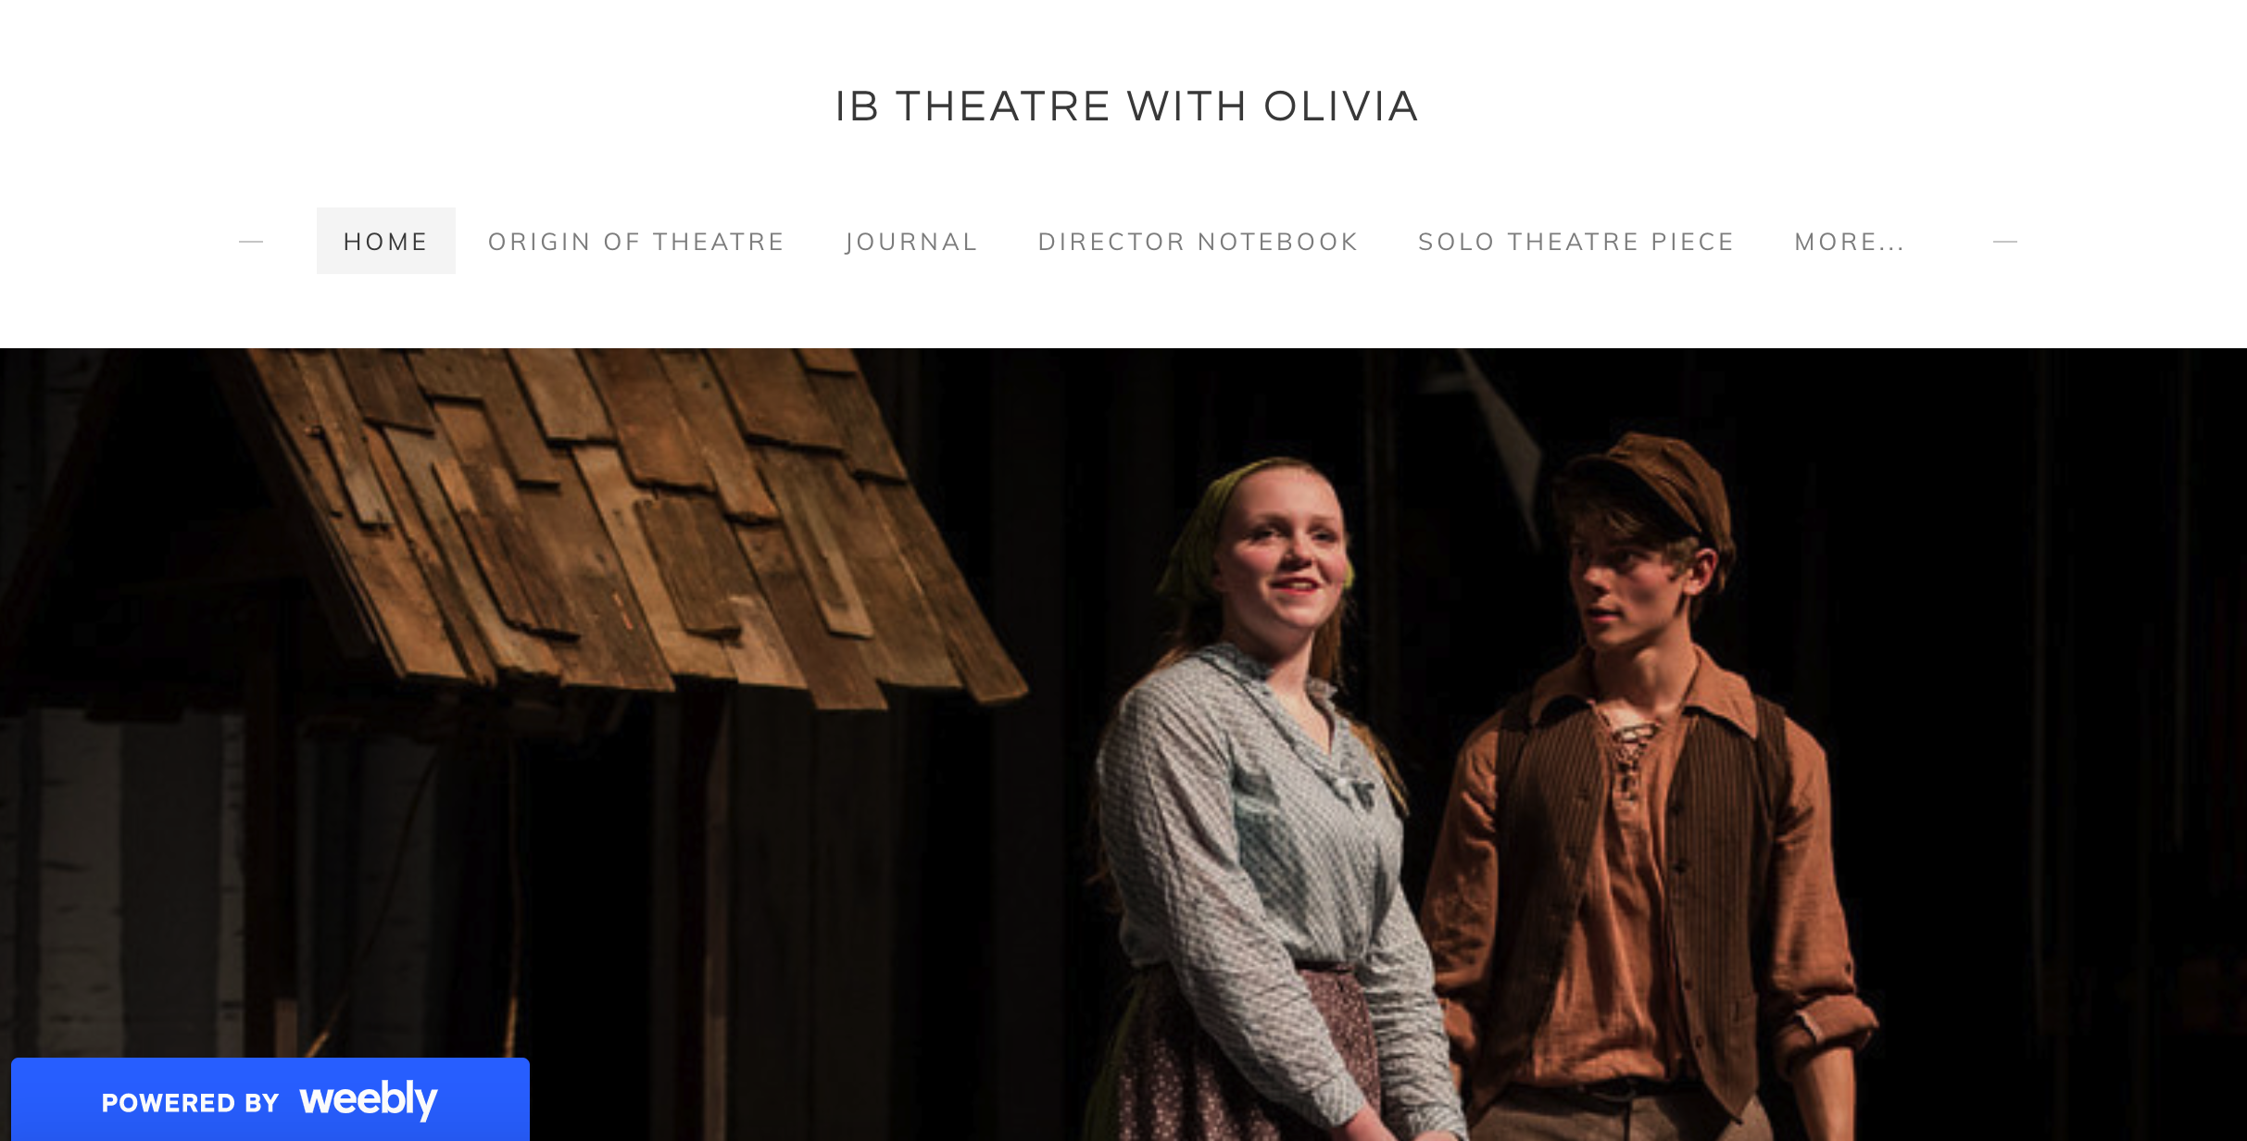
You design your own website to document your journal work! OR you can write your journal, take photos and post them on a google site.

Slide 13
Resources for Research
West Sound Academy IB Theatre has one of the best-curated collections of academic resources collections in the IB School Community.

Slide 14
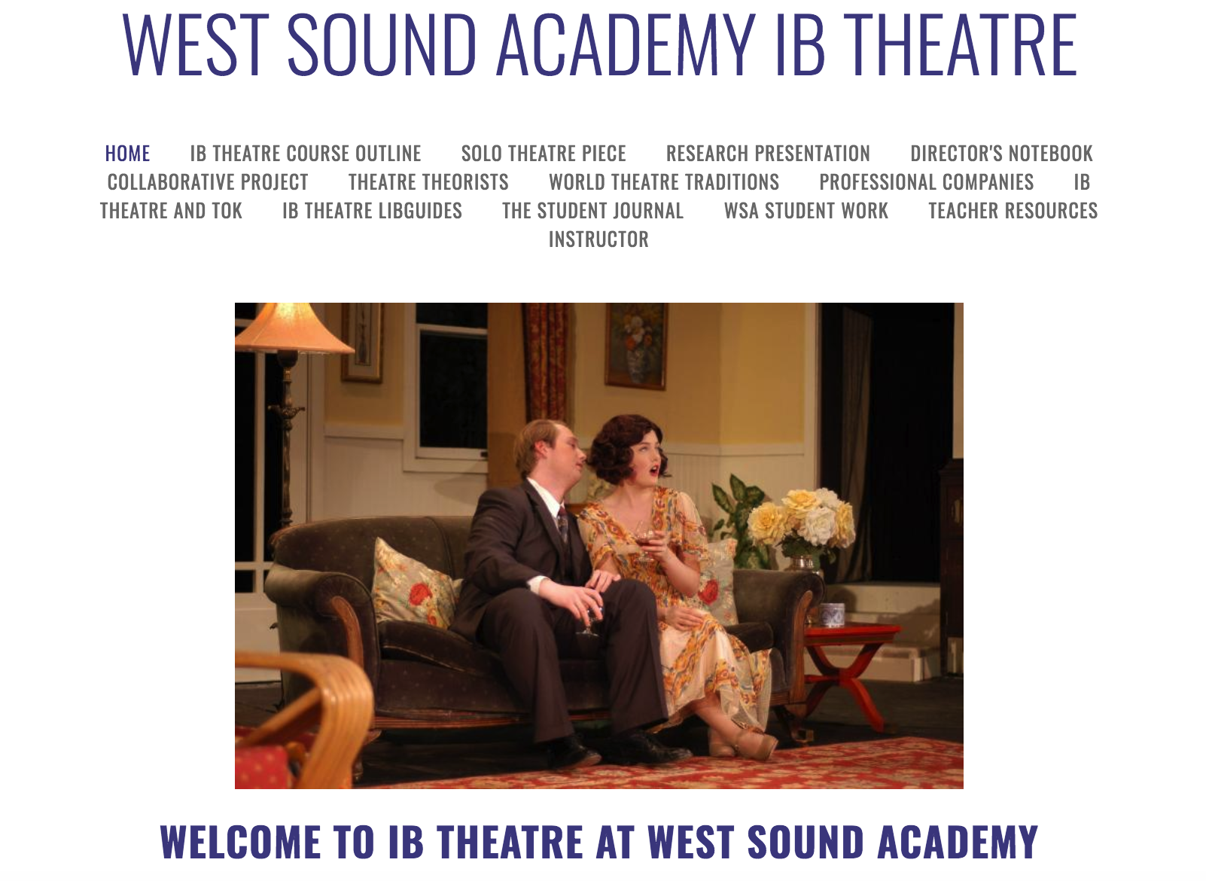
Globally respected website at your fingertips

Slide 15
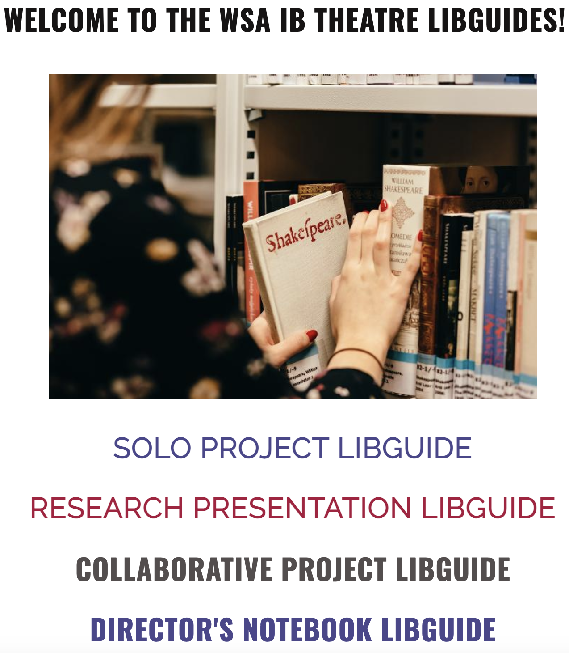
LibGuides have been curated for every Assessment
PRODUCTION PROPOSAL LIBGUIDE

Slide 16
Students also have access to
Digital Theatre Plus
Drama Online

Slide 17
Workshops with professionals from around the world

Slide 18
So, what do the current 1st year WSA
students have to say about IB Theatre?

Slide 19
The PROS of IB Theatre as your Group 6 course -
IB Theatre gives us the opportunity to explore different art forms
We are allowed to imagine a world that doesn’t exist
The work is Project based
Little note taking (clear handouts and pptx provided)
Inquiry is the name of the game - research based projects with resources available
You write your journal reflections and notes and the process papers literally write themselves.
In-class work time means time to rehearse, create, research and collaborate in ALL areas
Students MENTOR one another on projects - you never work alone

Slide 20
The Pros Continued
Individual attention from teacher
There is acting, but public performances are minimal and you have class time to rehearse and create
You complete MOCK Assessments before you complete the final version of your assessment
Semester Exam - You answer Reflection Questions and then have a Consultation with the Instructor
ALL of the assessments are done over the two years and then submitted to IB
Before filming each final assessment, you share and preview your work with your peers and teacher for feedback - then you film your best work to submit to IB
There are NO IB Exams your senior year= more study time for the other 5 subjects

Slide 21
Cons
Writing - Students write reflections for every class. (if you don’t like writing and if you get behind in your IB Theatre Journal entries then your process papers will be challenging to finish)
Lots of independent research (but you can always ask the teacher & your peers & 2nd Yr students for guidance and ideas)
Independent Inquiry - If you are not curious and are not willing to go looking for resources and information this course is not for you.

Slide 22
Myths about IB Theatre &
the Arts in general
I won’t get into a top university with an arts subject
It’s hard to get a 6/7 in
an arts subject - you only need a solid 5!
Arts subjects are ‘soft’

Slide 23
Facts
about IB
Theatre at WSA
It’s hard to get score 6/7 in all subjects. In most arts subjects, you don’t have an exam, so you have more control over your marks and are freed up to study for 5 subjects’ exams only in the Spring.
WSA Students with Group 6 arts subjects have gotten into:
UW, University of Puget Sound, Pacific Lutheran University, UMass Amherst, Ithaca College, Stanford, and many more.
Arts subjects are seriously challenging, academic, research-based subjects that will teach you more about the research process, creative and critical thinking, problem-solving and collaborating than many other subjects. Arts subjects teach you to learn, to analyse, to reflect, evaluate, refine and revise.
The average scores for IB Theatre at West Sound Academy are 5’s and 6’s. There have been WSA IB Theatre students who have earned a 7 as their final score at as WSA.

Slide 24
Pamoja Online Reality Check
A Pamoja class is entirely online - as yourself did you enjoy learning in Zoom?
Student Fact: “There are no teachers here at WSA to answer your subject questions and it is so frustrating. I don’t even know all the vocabulary for my exam or the equations I’m supposed to use.” (quote from a current WSA Pamoja student.)
Course work with Pamoja - Work is assigned on Wednesday and it is due the following Tuesday - no if, ands or buts.
Late work: If you do not have your homework done done and turned in - you receive no credit for that assignment. There is no negotiation.
You are responsible for completing your work whether your questions have been answered or not.

Slide 25
Straight Facts about Earning the IB Diploma
You need to a combined score of 24 to earn the IB Diploma
What do you need: Earning the diploma is based on a combination of your HL & SL assessments + your EE grade + your TOK score + completing CAS and together those must equal 24 (or higher) = your IB Diploma
For your Group 6 you should choose the course you feel you will score the highest in to maximize your chances of earning the DP whether you choose HL or SL
Many students tell me “I’m taking the Pamoja course because it is the subject I want to study in college,”
You need to get into college first - so focus on getting the diploma NOW and then you can study that other subject when you get to college.
Remember - “As many as 50 to 75% of all undergraduate students change majors at least one time before earning a degree.”
Source: https://exploration.osu.edu/Breaking%20Up%20Is%20Hard%20to%20Do/Changing%20Majors%201.14.pdf

Slide 26
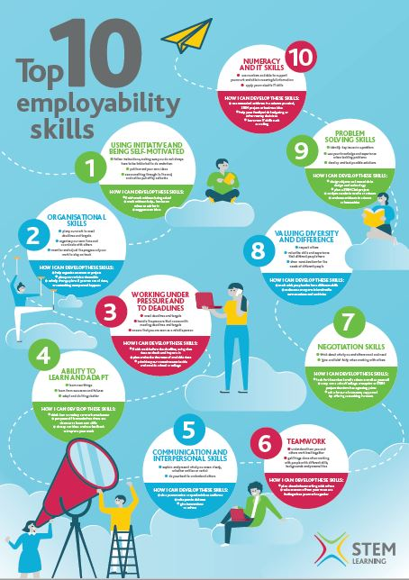
USING INITIATIVE & BEING SELF-MOTIVATED
ORGANISATIONAL SKILLS
WORKING UNDER PRESSURE & TO MEET DEADLINES
ABILITY TO LEARN & ADAPT
COMMUNICATION & INTERPERSONAL SKILLS
6. TEAMWORK
7. NEGOTIATION SKILLS
8. VALUING DIVERSITY & DIFFERENCES
9. PROBLEM SOLVING SKILLS
10. NUMERACY & IT SKILLS
EVERYTHING WE LEARN IN IB THEATRE
except maybe that one
Notes:
These are the top 10 skills employers are looking for today -

Slide 27
Do you
have any
Questions?

